Slide 1
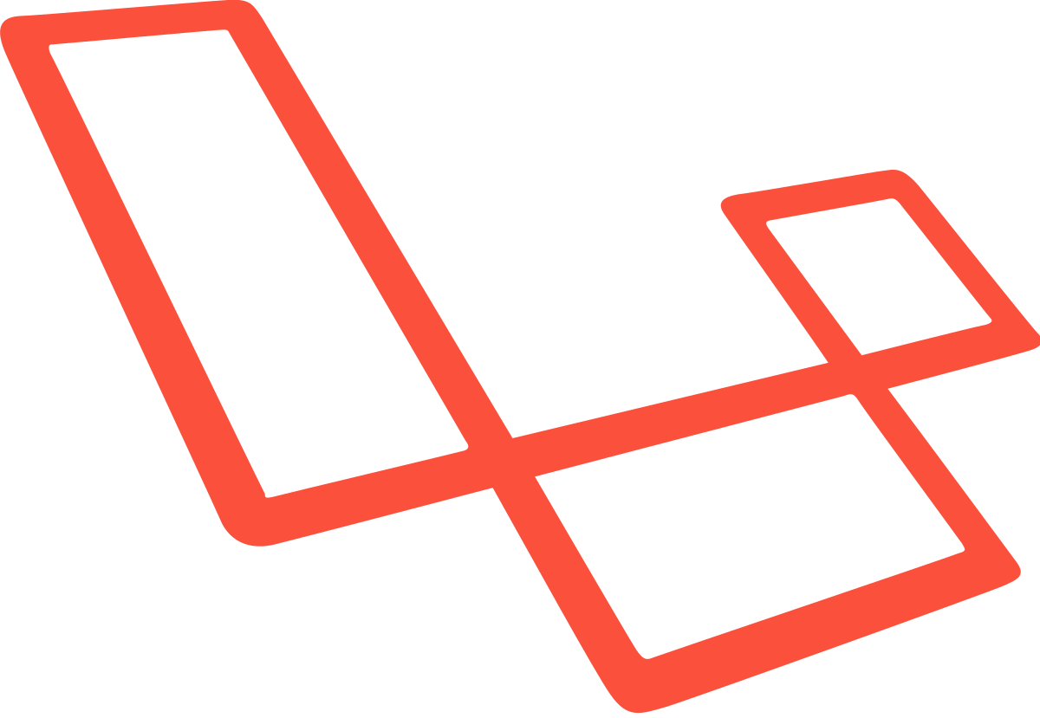
What is Object-oriented Programming?
By Min Thet Naing

Slide 2
A Programming paradigm centered around objects rather than functions.
By Min Thet Naing

Slide 3
OOP is not a programming language or tool!
By Min Thet Naing

Slide 4
Languages that support OOP
C++
Java
C#
Ruby
Python
Javascript
PHP (since version 5)
By Min Thet Naing

Slide 5
Frameworks and CMS
Laravel
Symfony
CodeIgniter
Drupal 8
October
Wordpress (additional parts)
By Min Thet Naing

